Slide 1
Class 27: Biases & backfire effects Monday, March 18
INFO 3402: Representations of Data Professor Brian Keegan brian.keegan@colorado.edu

Slide 2
Agenda
11:00 – 11:05: Week overview
11:05 – 11:25: Cognitive biases, Dunning-Kruger Effect, Activity 1
11:25 – 11:50: Debunking misinformation, Activity 2

Slide 3
Recap
Weeks 1 & 2 → Module 1: Exploring
Characteristics of a good question, Exploratory data analysis checklist
Weeks 3 & 4 → Module 2: Retrieving
Using requests, BeautifulSoup, etc. to scrape data from websites and APIs
Weeks 5 & 6 → Module 3: Cleaning
Creating tidy data (pivoting, melting, stacking) and handling missing data (dropping, filling, interpolation)
Weeks 7 & 8 → Module 4: Combining
Evaluating types of joins, deanonymization attacks, data aggregators
Weeks 9 & 10 → Module 5: Aggregating
Groupby-aggregation, split-apply-combine, viewpoint diversity, moral matrices

Slide 4
Upcoming events
Module Assignment 05 due Monday, April 1 by 10:59am
Final Project Proposal due Monday, April 8 by 10:59am
Three modules until end of class!
Weeks 9-10: Aggregating → groupby-aggregation, viewpoint diversity, moral matrices
Week 11: Spring Break!
Weeks 12-13: Inferring → hypothesis testing, regression, causation, counterfactuals
Weeks 14-15: Extrapolating → forecasting, prediction, paradoxes, logical fallacies
Week 16: Final Project Presentations

Slide 5
Module Assignment 05
In-class critical response process feedback on Friday, March 22
Due Monday, April 1 by 10:59am on Medium (yes, this is the Monday after Spring Break)
Objective: EDA about a contentious social issue and write up results using viewpoint diversity strategies
Summarize: What are good-faith representations of arguments on each side? What biases might you have or why opponents act in this way? What are the moral matrices/ethical frames that are in play?
Identify: What kinds of empirical data could be brought to bear on this question? What kinds of data do opponents rely upon? What are limitations of your data? How will this influence your analysis strategy?
Strategize: What kinds of cognitive biases and backfire effects should you anticipate triggering? How does this change your strategies for engagement or the kinds of arguments you will make?
Analyze: Perform a context-aware EDA on a dataset. How do the findings support or challenge your own assumptions and your opponents’ assumptions? Make a persuasive case for your findings in light of moral matrices, backfire effects, cognitive biases, engagement strategies, etc.

Slide 6
Final project
New Critical Response Process schedule after spring break
CRP on final project progress: April 5, April 19
CRP on module assignments: March 22, April 12, April 26
Third of class present on final project proposal/progress each session (5% of final grade)
Slide presentation with background/motivation, research question/hypothesis, data, methods, findings, discussion
Final project presentations in-class Week 16 (April 29, May 1) (10% of final grade)
Stand-up presentation in style of a TED talk
Final project write-up to be submitted to class Medium as blog post by May 7 (20% of final grade)

Slide 7
Cognitive biases
List of cognitive biases
https://en.wikipedia.org/wiki/List_of_cognitive_biases
Decision-making, belief, and behavioral biases
Social biases
Memory biases

Slide 8
Cognitive biases
Buster Benson’s “Cognitive bias cheat sheet”
https://betterhumans.coach.me/cognitive-bias-cheat-sheet-55a472476b18
Too much information
Not enough meaning
Need to act fast
What should we remember

Slide 9
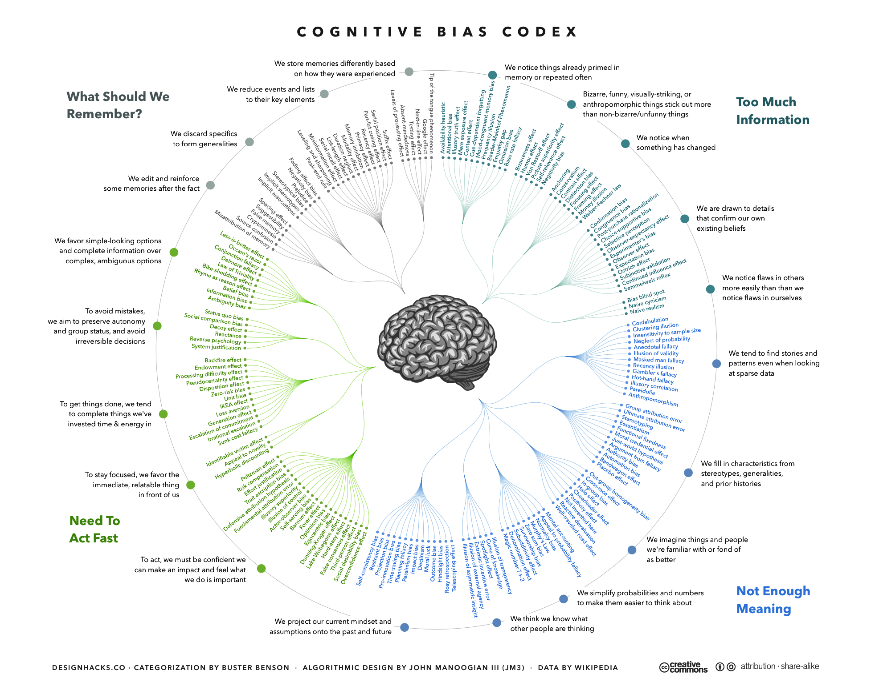

Slide 10
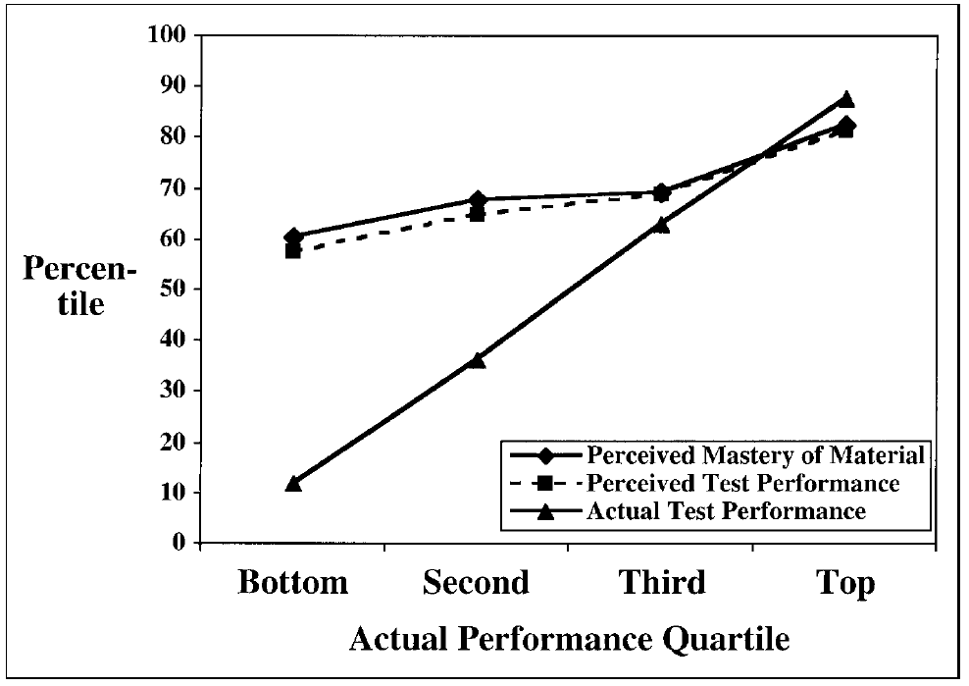
Dunning-Kruger effect
“Double curse of incompetence”
People’s incompetence inhibits accomplishment
Ignorance of incompetence leads them to over-estimate their performance
Compounded by “undue modesty” of competent people underestimating their performance
Figure 1 from Dunning, Johnson, Ehrlinger, & Kruger (2003).

Slide 11
Activity 1
Break out into groups for 15 minutes
Review the “List of cognitive biases” from Wikipedia
https://en.wikipedia.org/wiki/List_of_cognitive_biases
Map a recent experience onto one example from each of the three Wikipedia sections
Decision-making/behavioral biases, social biases, memory biases
What interventions could potentially limit this bias?
Report out your best example

Slide 12
Origins of misinformation
Lewandowsky, et al. (2012). “Misinformation and Its Correction.”
Psychological Science in the Public Interest, 13(3): 106-131.
Rumors and fiction: emotionally arousing stories most likely to spread, incorporating fictitious knowledge with their assumptions, fiction can convey pseudo-scientific ideas
Governments and politicians: politicians introduce misleading or false information to win support for or against policies
Vested interests: fear, uncertainty, and doubt (FUD) or “agnogenesis” strategies to conspire to avoid regulation/oversight
Media: oversimplification, misrepresentation, overdramatization; misplaced focus on balance
Selective exposure (“echo chambers”) is media consumption biased towards similar & affirming perspectives
Strategic extremism relies on selectively channeling ideas to supporters without alienating others

Slide 13
Recipients’ strategies for assessing truth
Lewandowsky, et al. (2012). “Misinformation and Its Correction.”
Psychological Science in the Public Interest, 13(3): 106-131.
Is this information compatible with other things I believe to be true?
Logical compatibility, avoiding inconsistencies, low-effort search, elicits positive feelings
Is this information internally coherent?
Fits with other narratives, easy-to-remember and process
Does this information come from a credible source?
Perceptions of credibility and expertise; lack of attention to situational indicators; focus on gist more than source
Do other people—especially people I trust—believe this information?
Repeated exposure; social consensus; pluralistic ignorance; false consensus effect

Slide 14
Continued influence effect
Lewandowsky, et al. (2012). “Misinformation and Its Correction.”
Psychological Science in the Public Interest, 13(3): 106-131.
Retractions rarely have intended effect of eliminating reliance on misinformation
Enhanced negation, temporal and contextual proximity, clarifying correction all fail to significantly improve
Mental models: people fill in gaps in understanding with inaccurate but congruent information
Retrieval failure: confusion/misattribution, early & plausible info retrieved first, negation is a poor update
Familiarity: if thoughts flow smoothly, why question them?; myths remembered more than facts
Reactance: people do not want to be told what to think or how to act
Pre-exposure warnings; repeated retractions; provide alternative narratives

Slide 15
Skepticism of alternative worldviews
Lewandowsky, et al. (2012). “Misinformation and Its Correction.”
Psychological Science in the Public Interest, 13(3): 106-131.
Worldview/ideology plays an important role in persistence of misinformation
Retractions fail to reduce reliance on misinformation when retraction violates personal beliefs
Backfire effects: corrections cause people will refer more to misinformation in line with beliefs
Tame worldview by affirming it

Slide 16
Backfire effects
Lewandowsky, et al. (2012). “Misinformation and Its Correction.”
Psychological Science in the Public Interest, 13(3): 106-131.
Familiarity Backfire Effect: Mentioning the myth can familiarize/legitimize it
Don’t mention the myth, but focus on the facts
Overkill Backfire Effect: Simple myths are more attractive than complicated/overwhelming corrections
Corrections should be easy to process, avoid dramatic or derogatory language → keep it simple
Worldview Backfire Effect: People seek and process information to confirm their identity
Cut losses on unswayable minority, explicitly affirm identity when presenting worldview-threatening messages
Sensemaking Backfire Effect: People prefer an incorrect explanation over an incomplete explanation
Debunking must fill in gap and explain features/anomalies of a story

Slide 17
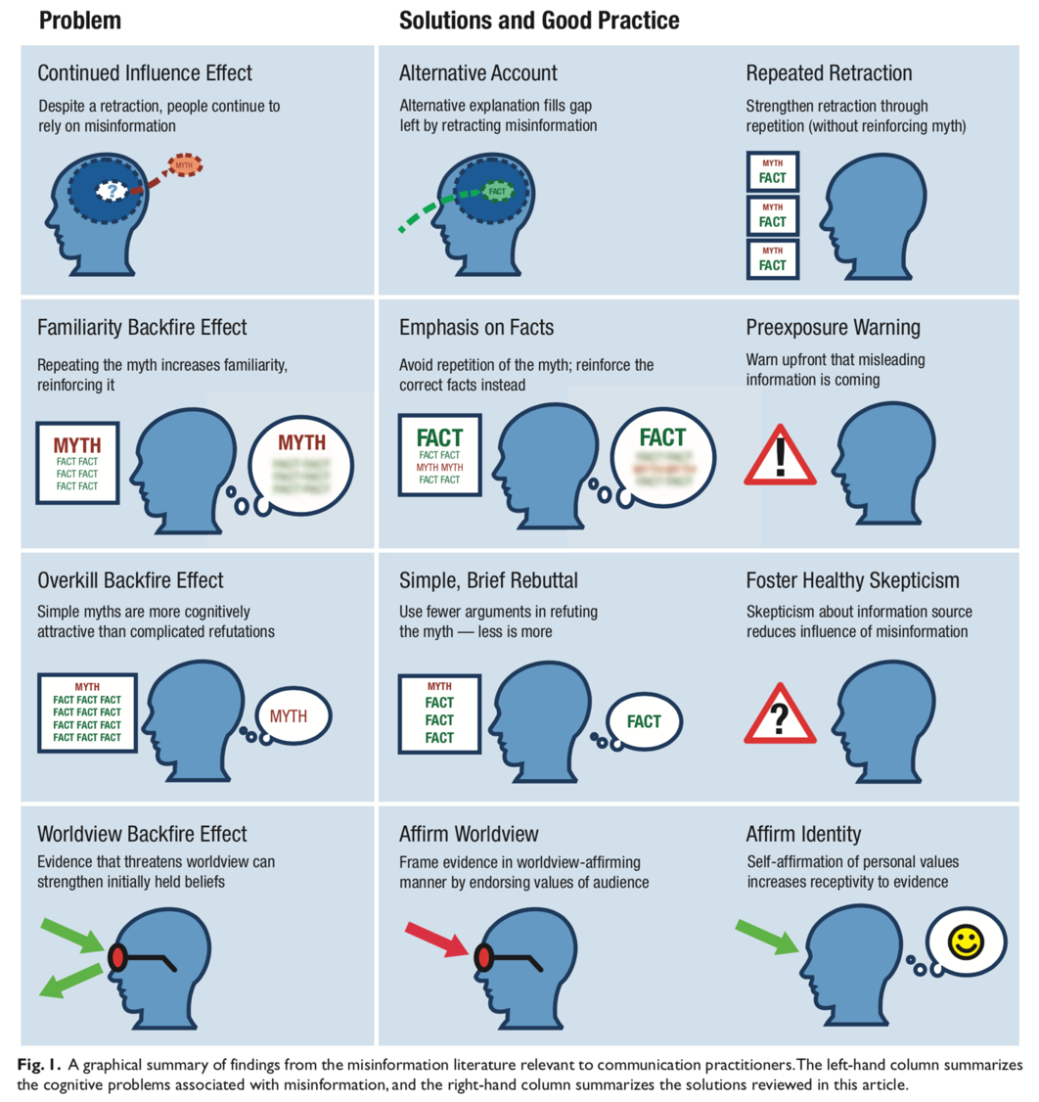
Solutions
Fill gaps in mental models with alternatives
Use repeated retractions (but carefully)
Emphasize facts over the myth
Provide warnings before mentioning myths
Use simple & brief material
Consider worldviews of audience
Present worldview-affirming arguments
Choice architectures rather than debiasing
Lewandowsky, et al. (2012). “Misinformation and Its Correction.”
Psychological Science in the Public Interest, 13(3): 106-131.

Slide 18
Activity 2
Break out into groups for 15 minutes
Identify an issue with lots of misinformation: climate change, vaccine safety, Obama birth certificate, etc.
Come up with examples of backfire effects and strategies for addressing myths more persuasively
Report out best examples and strategy

Slide 19
Next class
Open Mind framework
Three ethics and moral matrices
Applying to Module Assignment 05

